Slide 1
Technology-Field Classification using Machine-Learning (Deep-Learning)
Michael Freunek, Catalin Cris
Swiss Federal Institute of Intellectual Property

Slide 2
Motivation – Why Patent Classification?
Patents are classified by patent examiners according to technical features / technology-field / type of invention
Reason for patent classification
Allows
systematic organization of inventions
systematic search for state of the art (important for patent examination)
systematic monitoring of technology trends

Slide 3
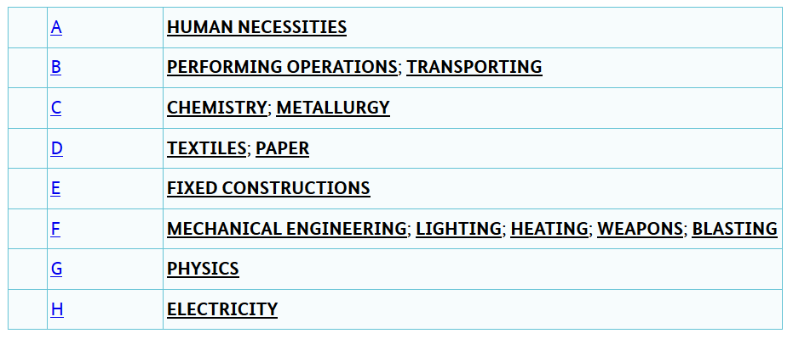
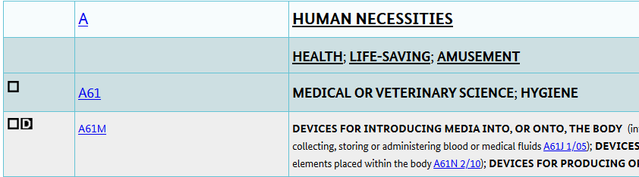
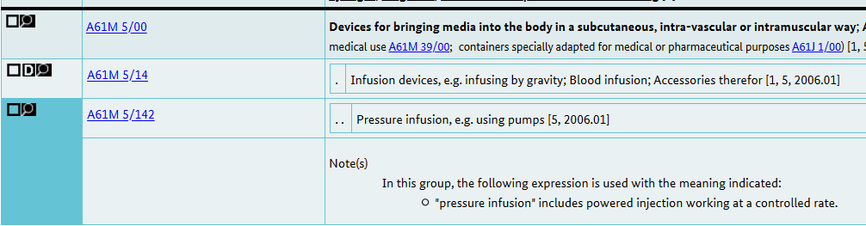
Example for Classification System International Patent Classification (IPC)

Slide 4
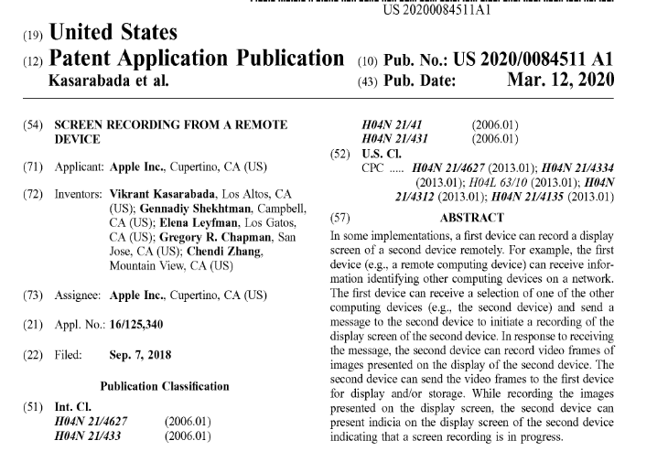
Example of Patent Classification

Slide 5
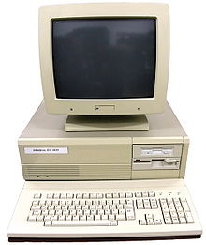
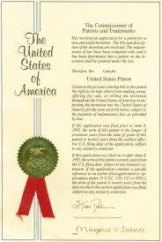
Goal: Applying ML for Patent Classification

Slide 6


Procedure: Selecting Documents
Input data from three technology-fields:
Insulin-pumps: IPC code A61M/142
Breaking-systems for vehicles: IPC code F16D65/00
Methods and devices to determine the density of materials: IPC code G01N9/00
Epoque Net
100 documents per technology-field
Report Manager
Python
Notes:
Wichtig: erklären, was Epoque Net und Report Manager sind.

Slide 7
Ablauf

Slide 8
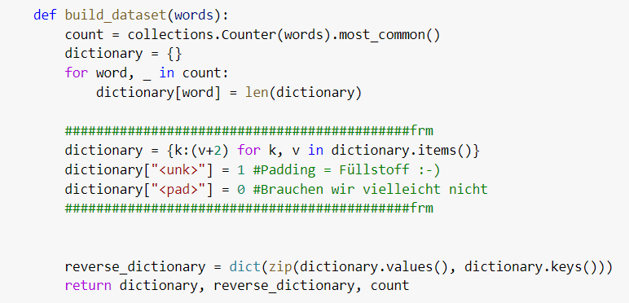
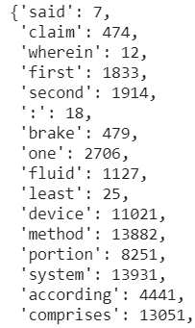
Procedure: Creation of Dictionary
dictionary

Slide 9
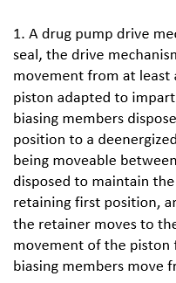
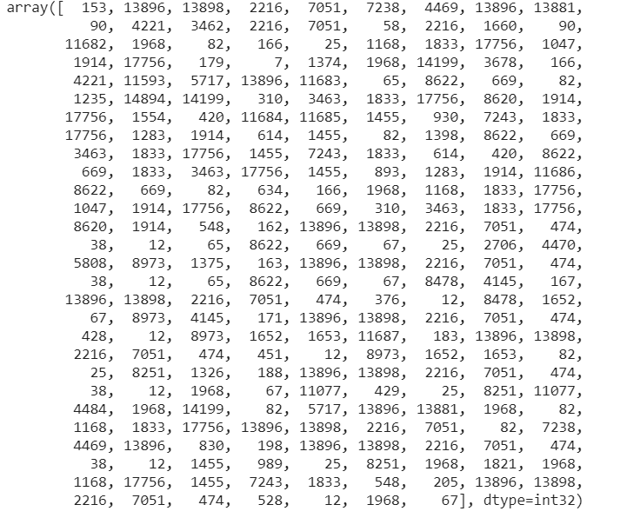

Procedure: Converting Text Documents
„Text in numbers“
„Text in words“
dictionary

Slide 10
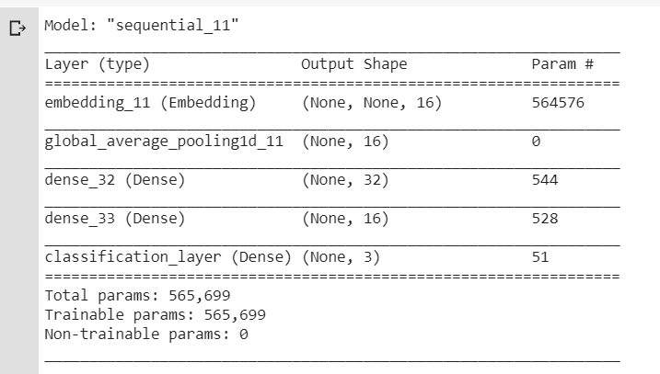
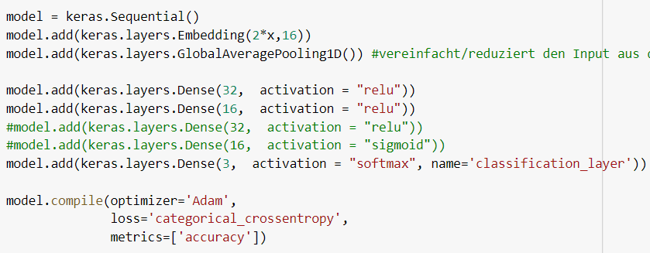
Procedure: Creation of ML-Model

Slide 11
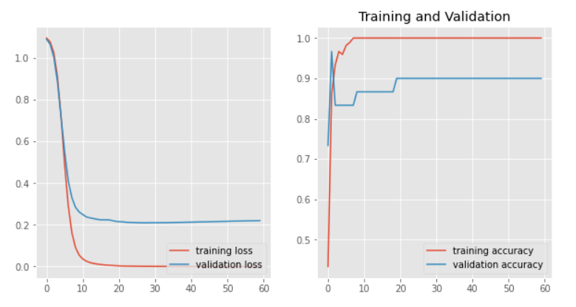
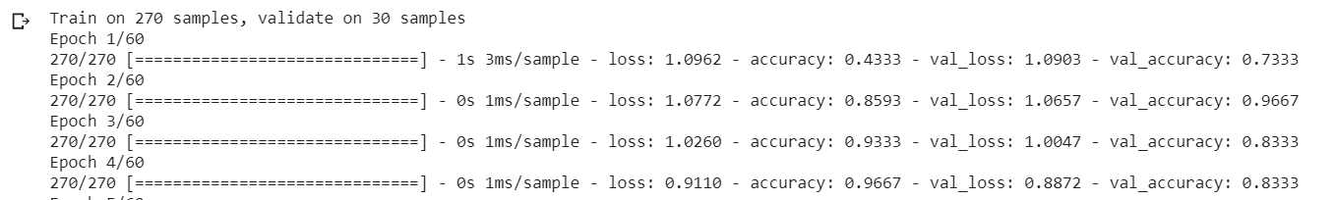
Procedure: Training of the ML-Model

Slide 12
Results: Model Prediction (approx. 40 docs. per Technology-Field) - 1

Slide 13
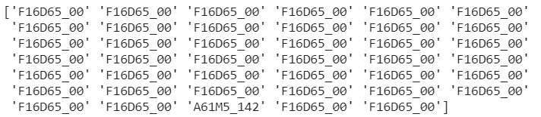
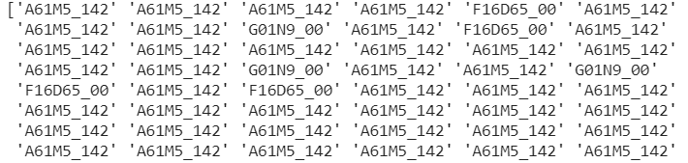
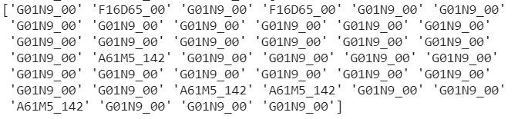
Results: Model Prediction (approx. 40 docs. per Technology-Field) - 2
Prediction for „vehicle-break“ documents
Prediction for „insulin-pumps“ documents
Prediction for „density-determination“ documents
(approx. 10 % misclassifications)

Slide 14
Optimization: „Parameters“ for our Sequential Neural Network
Number of layers
Number of neurons
Dimension „embedded layer“
Number of words per document (currently 300)
Activation functions
Loss function
Optimizer
Number of epochs
Batch Size

Slide 15
Thank you very much!

